Slide 1
Introduction:
Brief history of neural network research
Brain analogy
Applications of the perceptron
Deep-learning Neural Networks
Image classification by Convolutional Neural Networks

Slide 2
1960’s rudimentary knowledge of the brain suggests artificial neural networks for machine learning.
Brain has processing units (neurons) with connections (synapses) between them
Large number of neurons: 10¹⁰
High connectitivity: 10⁵
Capable of parallel processing
Distributed reasoning and memory
Robust to noise and failures
Lecture Notes for E Alpaydın 2010 Introduction to Machine Learning 2e © The MIT Press (V1.0)
2

Slide 3








Research on biologically motivated machine learning is popular in 1960s.
Training examples of a person
Humans are very good at
recognizing faces
but can’t say exactly
how it works.
An algorithm modeled after
the brain that can be trained
might give good results even
if we don’t know why.
Test images
Lecture Notes for E Alpaydın 2010 Introduction to Machine Learning 2e © The MIT Press (V1.0)
3
Notes:
3

Slide 4
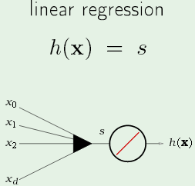
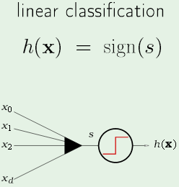
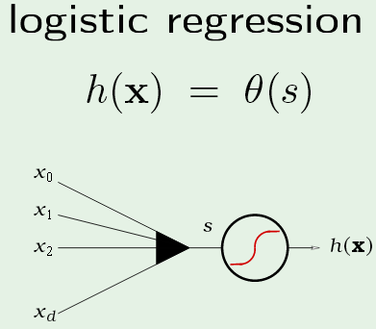
Brain analogy: Input from multiple neurons are combined to produce a signal s. Neuron receiving the signal can transform it before passing it on to another neuron.
Hard limit: output shift between two
values.
(0,1) or (-1,1),
No transformation
Soft limit: smooth transition between (0,1)

Slide 5
Brief history of research on ANNs
Rosenblatt proposes the “perceptron” and a learning method, the perceptron training algorithm (PLA). Publishes Principles of Neurodynamics (Spartan press 1961)
Lecture Notes for E Alpaydın 2010 Introduction to Machine Learning 2e © The MIT Press (V1.0)
5

Slide 6
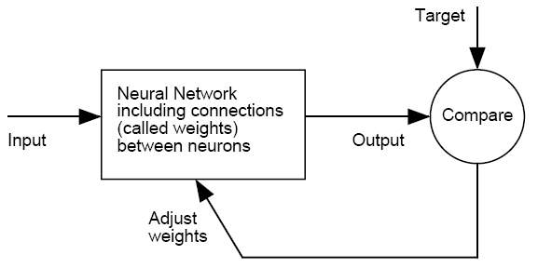
Paul Werbos (1974) describes a more general training method,
back propagation, in his PhD thesis. No one takes notice
Need rules that relate changes in weights to the difference
between output and target.

Slide 7
In perceptron applications, signal is a linear combination of the inputs, which includes a bias node x₀=1 in addition to attribute values. This signal can be written s = w^{T}x, where w is a weight vector to be optimized and x is the input attribute vector.
binary
h(x)=sign(w^{T}x)=+1
h(x)=sigmoid(w^{T}x)
h(x)=w^{T}x
Class membership
=1/(1+exp(-w^{T}x))
Probability of class
membership

Slide 8
Perceptron: Neural networks for linear approximations
Why use a linear model?
Easier to train
Less demanding of data
Generalizes better
Statistical analysis of results
Easier to interpret results

Slide 9
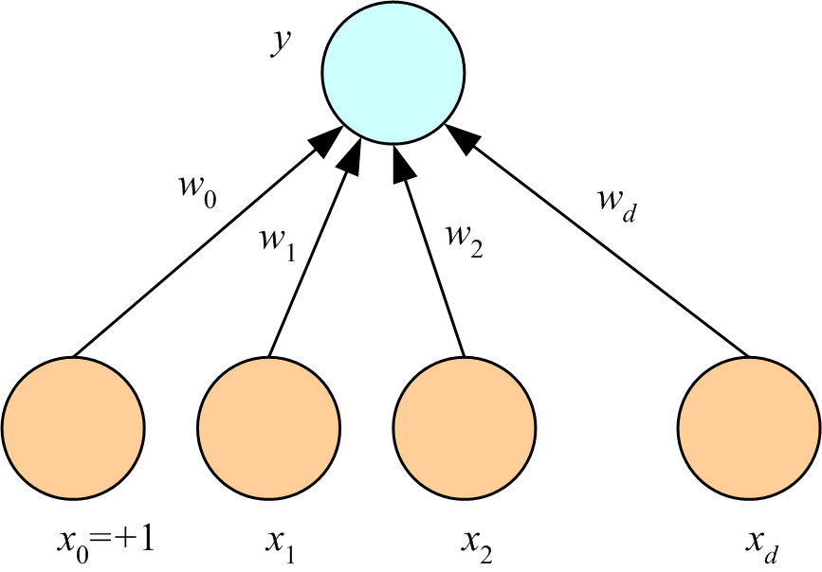
Perceptron for multivariate linear regression
First component of attribute vector is 1.
First component of weight vector called “bias”.
x is input vector
w is weight vector
y = w^{T}x
w^{T}x
…
Lecture Notes for E Alpaydın 2010 Introduction to Machine Learning 2e © The MIT Press (V1.0)
9

Slide 10
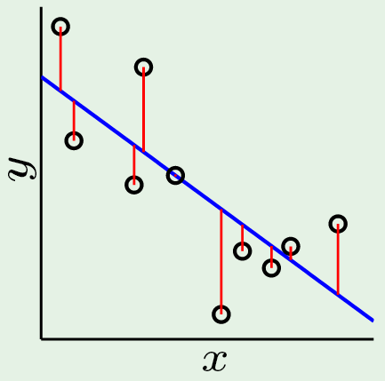
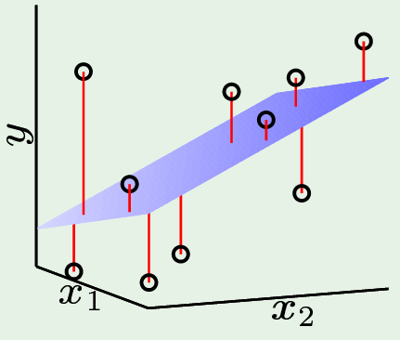
Regression with 1 and 2 attributes predicting a response
Fit a line to data: yfit = w₀+w₁x
Fit a plane to data: yfit = w₀+w₁x₁+w₂x₂
Similarly for any number of attributes used to predict the response

Slide 11
Attributes also called “predictors” of response
Fit a line to data: yfit = w₀+w₁x
Fit a plane to data: yfit = w₀+w₁x₁+w₂x₂
w₀ is not a “predictor”. It’s what we can say about the data in the absence of predicators. The average response is the best fit of a constant to data.

Slide 12
Perceptron for multivariate binary linear classification
x is input vector
w is weight vector
y = sign(w^{T}x)
+1 for class members
-1 for nonmembers
Called “hard limit”
sign(w^{T}x)
…
Lecture Notes for E Alpaydın 2010 Introduction to Machine Learning 2e © The MIT Press (V1.0)
12

Slide 13
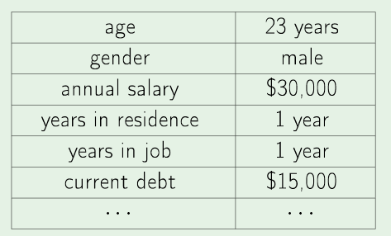
Meaning of bias nodes in classification:
Example: loan application
Should loan be approved?
Compare a linear combination of applicant's attributes to a threshold.
Both weights and threshold determined from historical data.

Slide 14
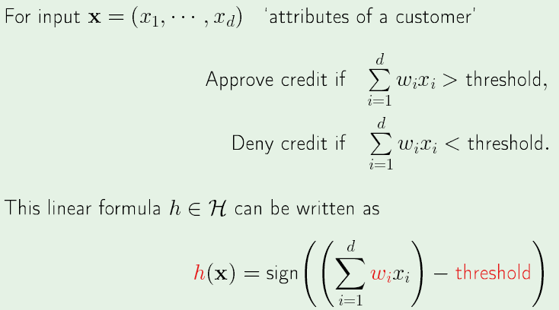
Bias node: Threshold for approval

Slide 15
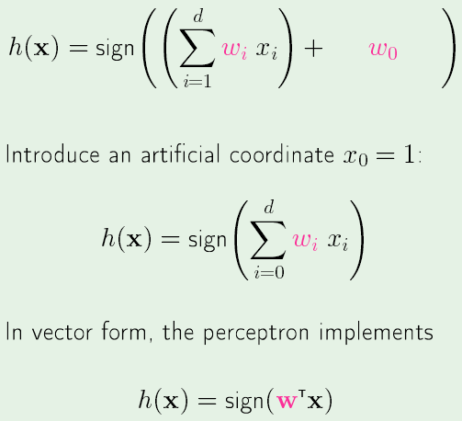
Include “threshold” in the attribute vector

Slide 16
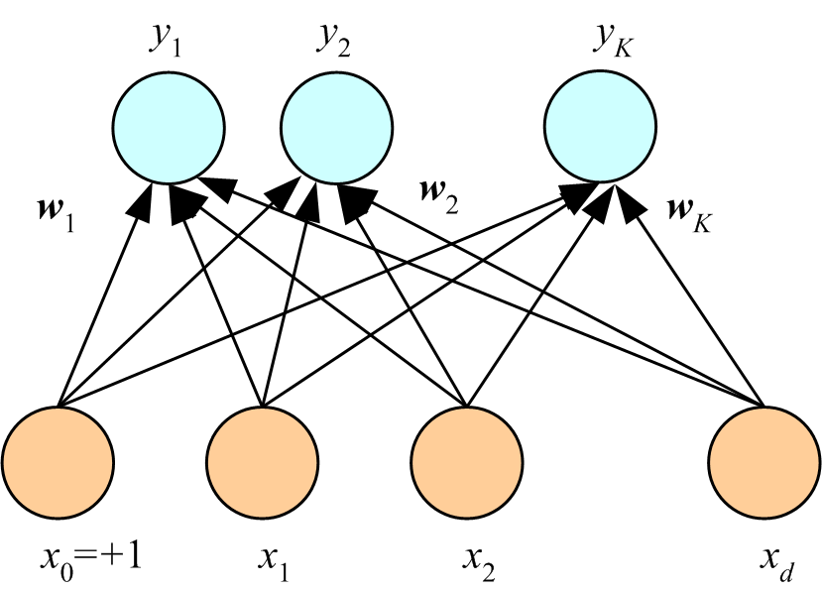
Structure of a perceptron for multi-class multivariate linear classification. Each class has its own weight-vector connection to the input that is a column of a weight matrix W with K columns and d+1 rows. Output is probability of membership. Sig stands for that sigmoid function.
Sig(w₁^{T}x)
Sig(w₂^{T}x)
…
Sig(w_{K}^{T}x)
…

Slide 17
Output y_{i} = Sigmoid(w_{i}^{T}x). Assign example to class with largest output (most probable class)
…
Sig(w₁^{T}x)
Sig(w₂^{T}x)
Sig(w_{K}^{T}x)
…

Slide 18
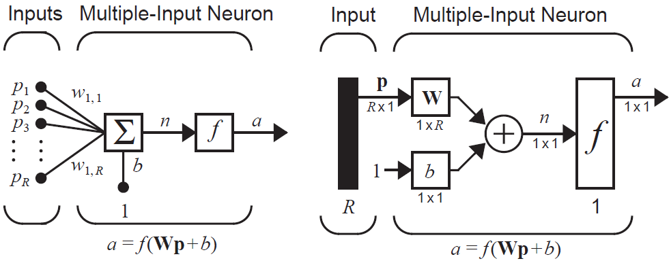
Alternative notation (Hagan, Demuth, and Beale)
Abbreviated form
Bias is separate from attribute vector p. Weights are row vectors in matrix W; hence not transpose is required. In this case W is 1xR. Input is transformed by W and b into n for “net”. Net is transformed into a in the output node.

Slide 19
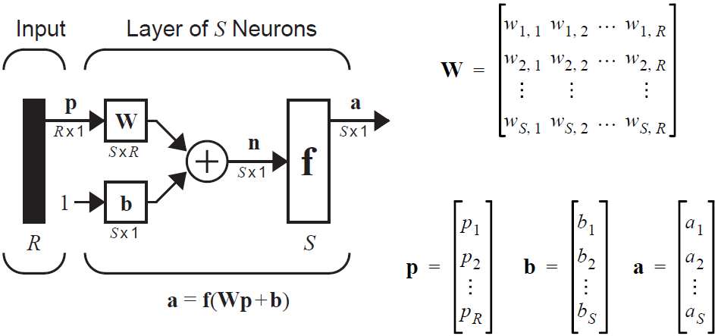
Multi-class multivariate linear classification, Hagan et al. notation, abbreviated form, S classes.
Weights are row vectors
Abbreviated form
Input and bias are column vectors

Slide 20
Rosenblatt recognized that without modification of the output
node, the perceptron was just another representation of
multivariate linear regression
x is input vector
w is weight vector
y = w^{T}x
w^{T}x
…
Lecture Notes for E Alpaydın 2010 Introduction to Machine Learning 2e © The MIT Press (V1.0)
20

Slide 21
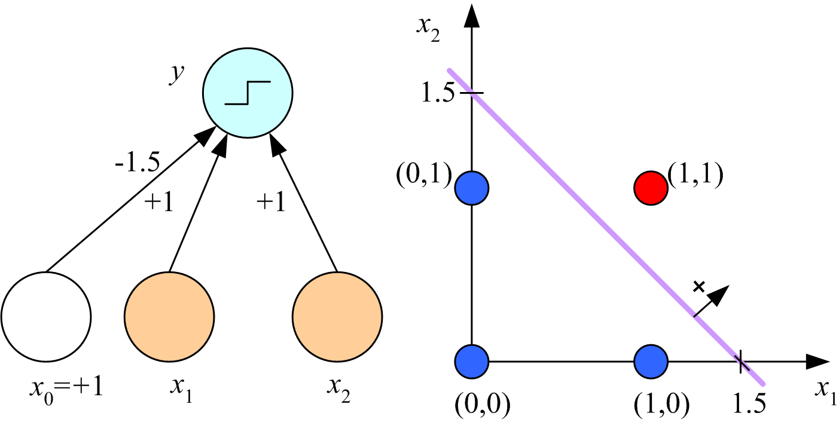
Rosenblatt developed the perceptron learning algorithm,
which uses y = sign(w^{T}x) in the output node to perform
multivariate binary linear classification. If the classes
are linearly separable, as in Boolean AND below, PLA finds a boundary in attribute space that separates members from non-members.
…
Lecture Notes for E Alpaydın 2010 Introduction to Machine Learning 2e © The MIT Press (V1.0)
21

Slide 22
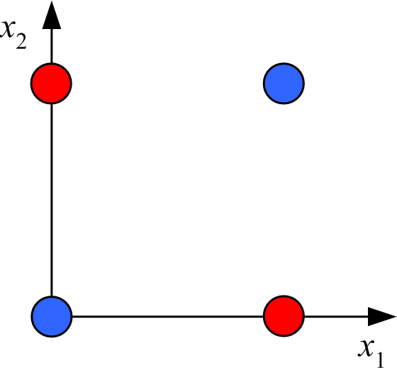
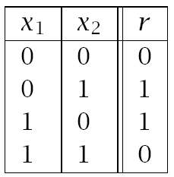
Minsky and Papert (1969) show limitation of Rosenblatt’s perceptron using Boolean XOR example:
Linearly inseparable binary classification problem
data table
graphical representation
PLA cannot find an exact solution. No line in attribute space that can completely separate members from non-members.
Delays development of ANN methods for many years.

Slide 23
Hopfield (1982) proposes multi-layer perceptron (MLP) trained by back propagation
Hinton (1986) publishes a practical back propagation method.
Stanford group publishes Parallel Distributed Processing (1986). Restarts ANN research.
Lecture Notes for E Alpaydın 2010 Introduction to Machine Learning 2e © The MIT Press (V1.0)
23

Slide 24
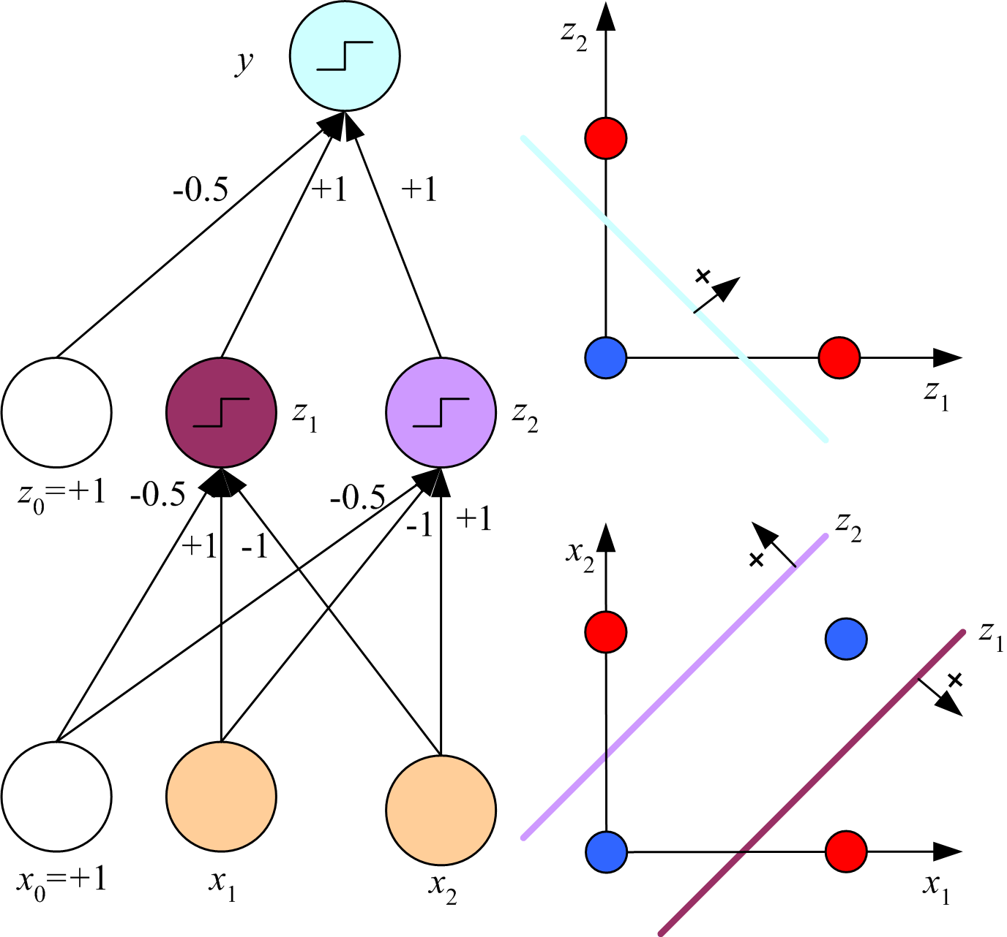
Volume 1 of Parallel Distributed Processing (1986) shows that limitations of Rosenblatt’s perceptron pointed out by Minsky and Papert (1969) can be overcome by multilayer perceptron (MLP)
1 weight vector connecting hidden layer to output defines a linear discriminant separating the hidden-layer features
-0.78
We will discuss this
solution in detail later.
2 weight vectors connect input to hidden layer that define linearly separable features.
24
MLP to solve XOR binary
classification problem

Slide 25
In 1990s, ANNs are de-mystified
ANN joins ranks of non-parametric statistical methods
Training methods are recognized as non-biological
In 2000s
Genome sequencing stimulates vast data-mining
New methods of data mining start replacing ANN

Slide 26
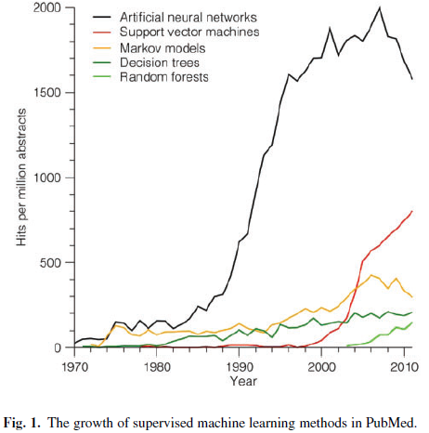
Rise and fall of supervised machine learning techniques, Jensen and Bateman, Bioinformatics 2011
ANN still exceeds the
sum of other methods

Slide 27
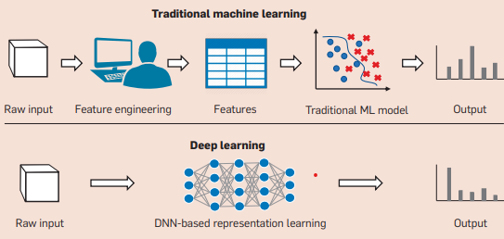
In 2010s
Neural Networks make a comeback with Deep Learning.
Perfect marriage between big data and machine learning
For tabular data, no evidence that deep learning is more accurate than traditional machine leaning based on human feature engineering.

Slide 28
Training the network by back propagation lets the data determine the features of the machine-learning model
For deep-leaning neural networks (DNNs) features, defined by the value of millions of weights, are uninterpretable by humans.

Slide 29
2012 Alex Krizhevsky (student of Hinton) publishes ImageNet, a deep convolutional neural network for image classification.
Age of images as data for machine learning is launched. Paper currently has 139747 citations. Citations/year peaked in 2021.
ImageNet has 60 million parameter that are weights connecting 500K neurons. Trained by 1.3 million high-resolution images from 1000 classes. Introduces Softmax to report the confidence of classification and Dropout layers to reduce overfitting.

Slide 30
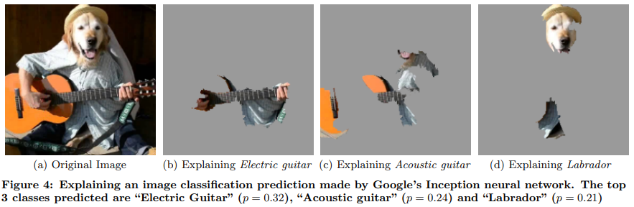
Analysis of deep-learning image classifiers can show the
most important part of the image for different predictions with different levels of confidence; however, image fragments (which humans understand) are not the features the algorithm uses to make the predictions.

Slide 31
In 2020s
“Can we trust a method if we don’t how it works?” becomes a
serious topic of neural network research.
Training examples of a person
Humans are very good at
recognizing faces
but can’t say exactly
how it works.
An algorithm modeled after
the brain that can be trained
might give good results even
if we don’t know why.
Test images
Lecture Notes for E Alpaydın 2010 Introduction to Machine Learning 2e © The MIT Press (V1.0)
31
Notes:
31

Slide 32
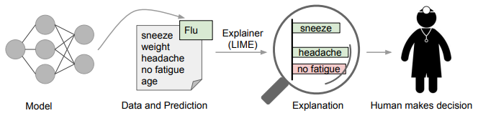
Explainable Machine Learning: What is it? Who needs it?
An “explainer” is an algorithm that extracts the basis for a prediction that can be judged by a knowledgeable person.
Most important when prediction has the potential for personal
harm, e.g., medical, loan application, job application, etc.

Slide 33
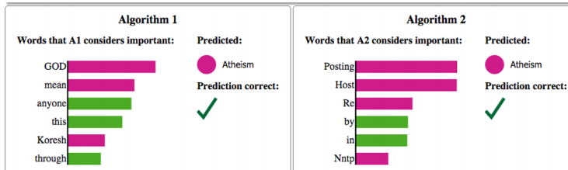
Comparison of natural language processing algorithms used to predict if
text is about Christianity or Atheism. Explainer extracts important words used in predictions.
Both predictions are correct, but the important words used by algorithm 1 make more sense to humans as a basis for the decision; hence the explainer algorithm gives us more trust in algorithm 1.

Slide 34
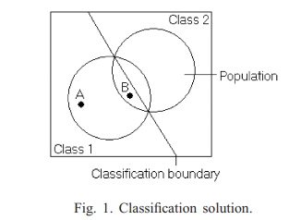
Increasing trust in DNN classification by reporting more than class assignment.
Both A and B are members of class 1 and correctly classified.
Explainer algorithm reports distance to decision boundary.
More trust in result for A than B because further from decision boundary
Noise is less likely to be factor in assignment of A to class 1

Slide 35
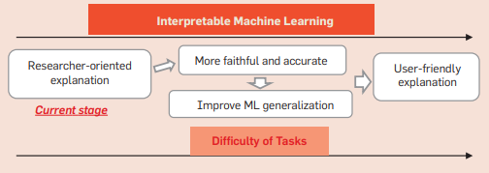
Where we are and what we expect to accomplish with
interpretable machine learning.

Slide 36
In 2020s Generative AI: Robotics combined with Large Language Model to create ChatGTP.
2023, Hinton leaves Google at 75. Sounds the alarm about generative AI.
“…generative intelligence could spread misinformation and, eventually, threaten humanity” (New York Times interview)
August 2023, The Principles of Data-Centric AI. Communications of the ACM vol. 66 no. 8 DOI: 10.1145/3571724
“…focus on the human-centered nature of data that feeds AI systems…”

